Slide 1
99 Problems But a Birch Ain’t One
Predicting canopy coverage in urban areas
Niamh Donnelly
Supervisor: Dr. Brian Mac Namee

Slide 2
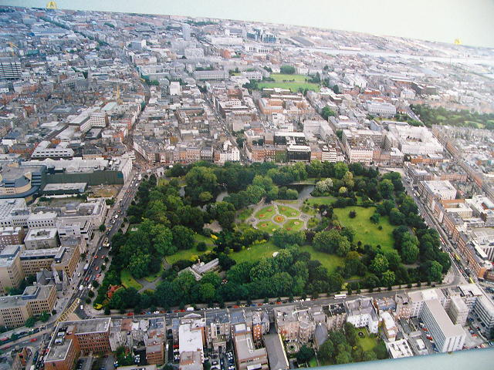
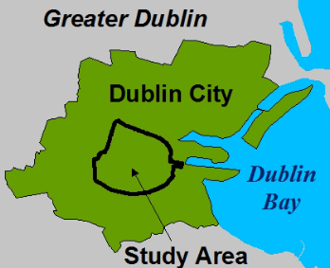
Welcome to the Concrete Jungle
- 10,000 Trees
- 9 Months
Notes:
Why do we need to know how many trees there are in a city?
3 main Reasons
Provide a habitat for wildlife
City planners need to know to be able to prepare for urban development
Reduce Co2 levels in the atmosphere
2012 study estimated 1000 trees in Dub City
Took 9 months of field work
Not only not affordable or viable on a large scale, it is just an estimate. Theres loads of areas they would not have been able to access, I really doubt that researchers were sending in ethics approval forms to get into peoples back gardens.
Researchers weren’t able to get all the trees for example couldn’t go into peoples back gardens or private property.

Slide 3
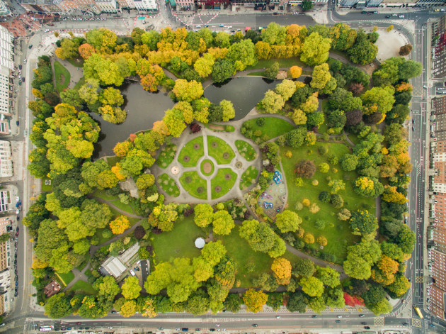

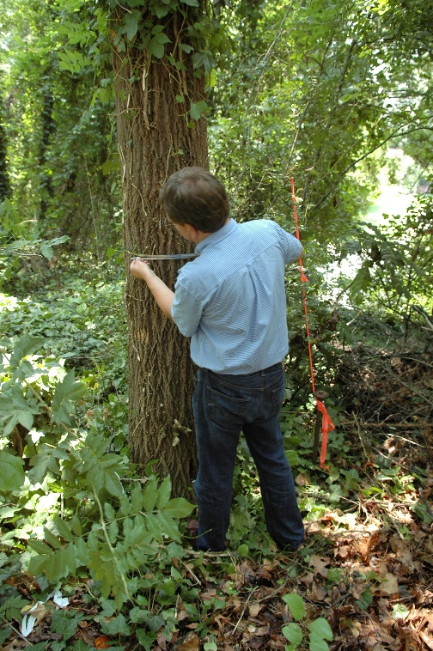


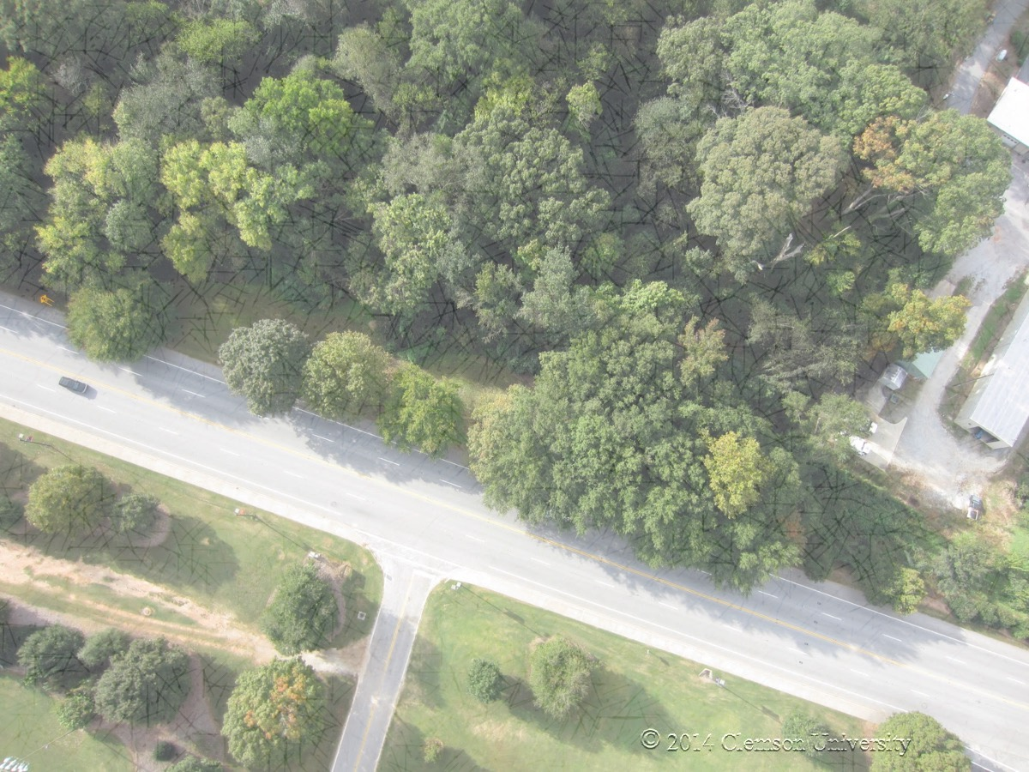
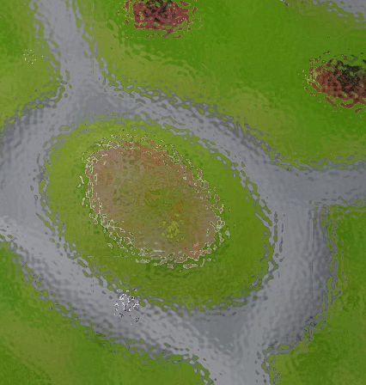
What Roots Can We Take ?
1. Manual Labelling
2. Traditional Machine Learning
Yup, it’s
a tree.
Non Tree
Tree
3. Deep Learning
Tree
Non Tree
Notes:
Lets take a look at different ways we could approach this problem
The first manual labelling – as we said before is not really feasible
Instead, we could automate this process by taking an image of a city and using a machine learning algorithm make a prediction for every pixel in the image.
Traditional ML techniques base this prediction of of the colors of pixels – but there is an obvious problem here. The colors of trees are very similar to the color of grass and other vegetation.
The state of the art way to make this type of predication is to use a Deep Learning technique called a convolutional neural network.
This does 2 things differently
Rather than just making a prediction based of the color of a pixel it also bases this of of the shapes that pixels make
So for a tree is can regonise the shapes of the crown and the leaves
2. Instead of looking at groups of pixels in isolation it takes into account the surounding neighbour hood of pixels
So CNNs have more information to base a prediction on

Slide 4
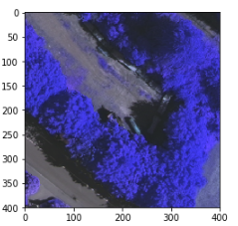
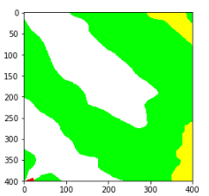
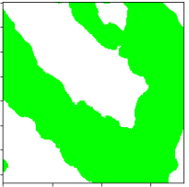
You Wood Not Believe the Results
85% Accuracy
Aerial Image
Human Interpretation
Model Result
Notes:
So I obtained access to a dataset of arial images of a city in Germany called Potsdamn
For this data set someone had gone and create segmented pictures outlining areas of tree and non tree
I used this data to train my convolutional neural network and produced this representation on the right – which as you can see looks almost the same as the humans interpretation which is what we want.
The models current accuracy is at 85% which is really good for the this particular dataset, It’s a little higher than some of the published results.
If you look at the gap up the top where it should be green this is just because there is a shadow covering the tree in the original image.
These small errors can be easily resolved using post processing techniques – and I think if I do this I can get the accuracy above 90% which is higher
Thank you so much for listening and if you want to know more about my project or want to hear some tree puns definitely come talk to me later

Slide 5
Thank You
Niamh Donnelly

